Slide 1
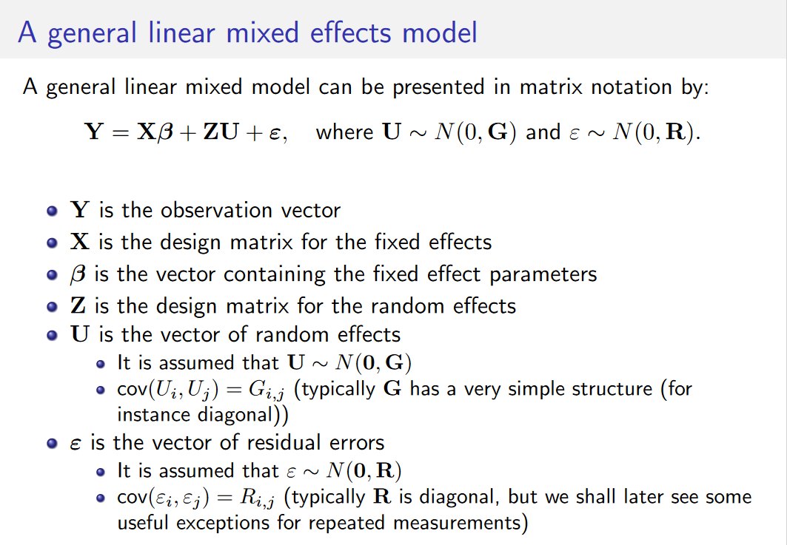

Slide 2


As a hierarchical model:

Slide 3
